Slide 1
DIABETIC RETINOPATHY DETECTION
PREETAM JAIN
SOUMYA ZACHARIA

Slide 2
PROBLEM STATEMENT
The aim of the project is to detect Diabetic retinopathy (DR), a medical condition in which damage occurs to the retina due to diabetes mellitus.
It is detected by the presence of microaneurysms, small saccular outpouching of capillaries, retinal hemorrhages, ruptured blood vessels—among other features—on the fundoscopic images
Manual grading by ophthalmologists is done by identifying diabetic retinopathy in retinal fundus photographs, which requires skilled labor and is time consuming.
A chronic eye disease that affects 80% of those who had diabetics for 20 years or more.
Nearly 415 million diabetic patients at risk worldwide.
Deep learning artificial neural network approach, can achieve high sensitivity and specificity in detecting the referable diabetic retinopathy, defined as moderate or worse diabetic retinopathy.

Slide 3



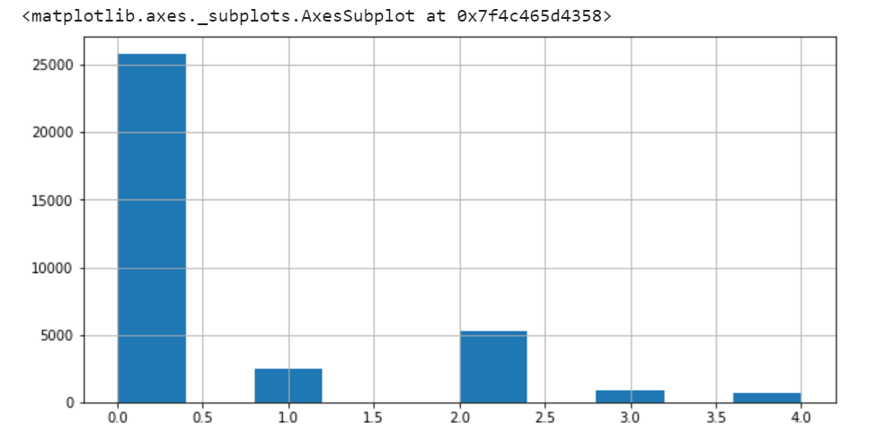
DATA
High resolution retina images taken under variety of imaging conditions
Left & Right field is available for every subject
Training set is labelled according to the presence of diabetic retinopathy by a clinician as 0,1,2,3,4 depending on the severity

Slide 4
Data Preprocessing
Data –images
Subsampled data to select images with levels 0, 3 and 4
Converted to binary classification problem
No DR-0
Levels 3,4 - 1
Resized- 256*256,
Image Enhancement,
numpy conversion
Train- Test split,
Normalisation

Slide 5
Handling large dataset
Subsampling data
Selected only the images with levels 0, 3 and 4.
Selected a smaller subset of images with level 0, since there was a huge data imbalance.
Converted it to binary classification problem.
Converted images into numpy arrays and stored .npy file the in drive. This saves time of converting all the images to np arrays and preprocessing the images

Slide 6
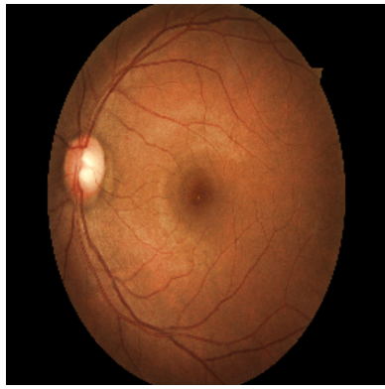
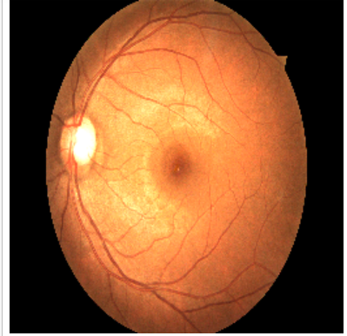
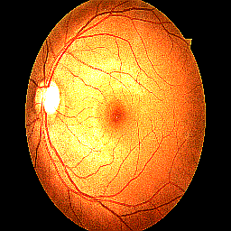
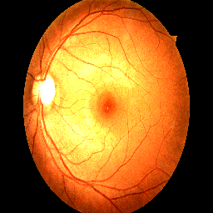
IMAGE ENHANCEMENT
Brightness
Contrast
Sharpness

Slide 7
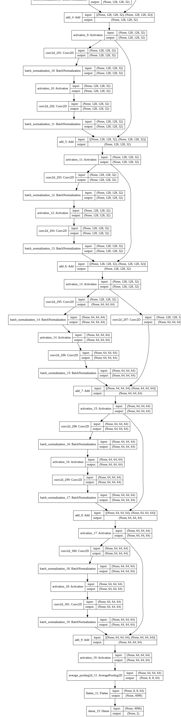
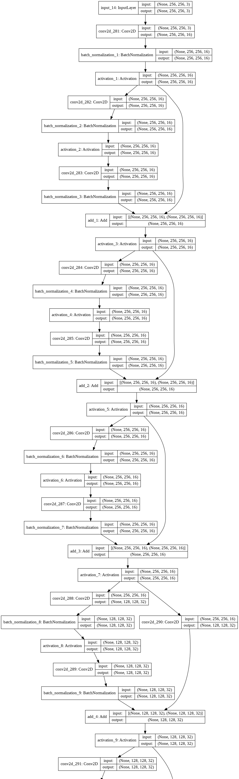
RESNET
ResNet model has “identity shortcut connection” that skips one or more layers.
Implemented Resnet 20
Total params: 281,986 Trainable params: 280,610 Non-trainable params: 1,376
Learning rate- e-3
30 epochs

Slide 8
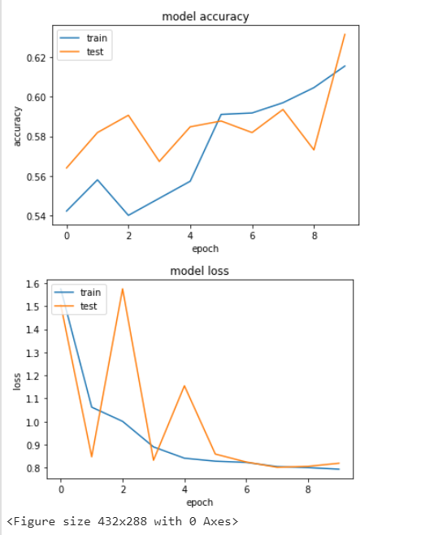
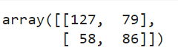
Resnet Model
CONFUSION MATRIX

Slide 9
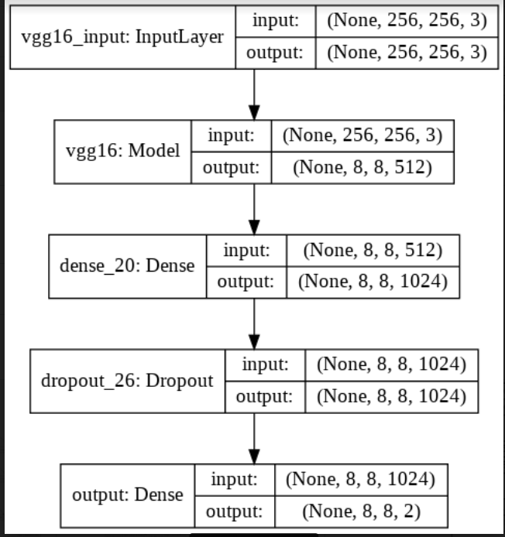
VGG
VGG
VGG-16 is a convolutional neural network that is trained on more than a million images from the ImageNet database.
The network has an image input size of 224-by-224.
We are using VGG-16 pre-trained through ImageNet
Total params: 15,242,050 , Trainable params: 5,246,978 Non-trainable params: 9,995,072

Slide 10
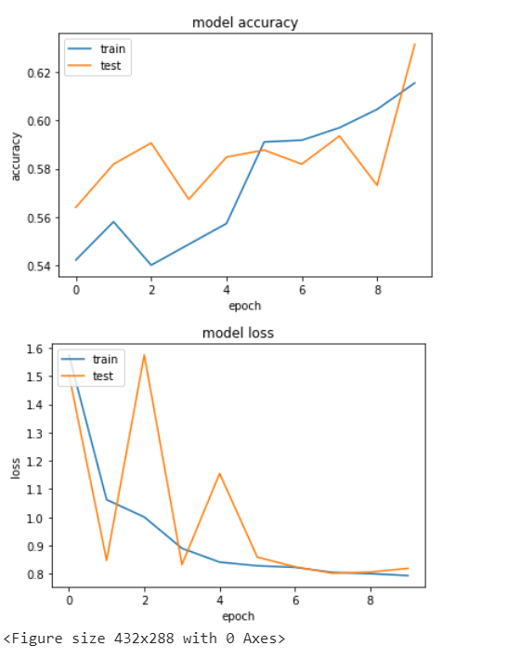
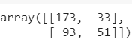
VGG model results
Confusion matrix- pretrained model

Slide 11
INCEPTION
Instead of adding a particular filter size layer, we add all 1x1, 3x3, 5x5 filters and perform convolution on the output from the previous layers
Inception V3- pretrained on imagenet
Image size-299*299

Slide 12
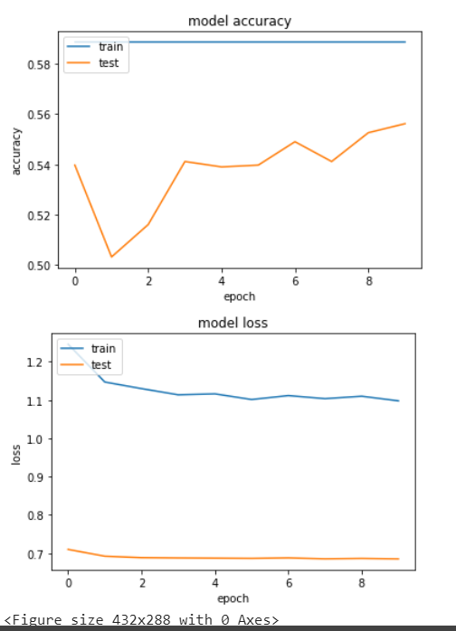
INCEPTION MODEL ACCURACY
The inception model training accuracy was not improving with the epochs
The model predicted all test images as 0

Slide 13
Google cloud platform(GCP)
Created a VM instance
Chose my machine type – 8v CPUs and 30 GB memory
Ubuntu 16.04 LTS – standard persistent disk – 10 GB size
GPU type – NVIDIA Tesla K80
GPUs – 2
Make external IP address as static
Change the Firewall setting and select specified protocols and ports
Start VM instance

Slide 14
Google cloud platform(GCP)
Install Jupyter notebook and other packages
- wget http://repo.continuum.io/archive/Anaconda3-4.0.0-Linux-x86_64.sh
- bash Anaconda3-4.0.0-Linux-x86_64.sh
Install other softwares:
- pip install tensorflow
- pip install keras
Set up the VM server:
- Open up a SSH session to your VM and check if you have a Jupyter configuration file using the command :
ls ~/.jupyter/jupyter_notebook_config.py

Slide 15
Google cloud platform(GCP)
create one, if it doesn't exist:
jupyter notebook --generate-config
Add few lines in configuration file :
c = get_config()
c.NotebookApp.ip = '*'
c.NotebookApp.open_browser = False
c.NotebookApp.port = <Port Number>
Replace the port number with the one allowed in firewall access
Launch Jupyter notebook
jupyter-notebook --no-browser --port=<PORT-NUMBER>
In browser : http://<External Static IP Address>:<Port Number>

Slide 16
CONCLUSION
Resnet model produced an accuracy of 63% with 30 epochs. The accuracy increased with every epoch. Resnet produced better specificity and sensitivity.
After training the model on 10 epochs and tuning hyperparameters the testing accuracy came out to be 62%But, the problem with VGG was as the epochs increases the loss was also increasing instead of decreasing. Also, the VGG16 architecture is very heavy and takes lot of computation power. So it was difficult to train VGG again and try to improve accuracy.
Inception model accuracy did not improve with epochs The model predicted all the image levels as 0
The accuracy produced by the above models are not good enough due to the presence of large data imbalance and the poor quality of the images.

